Slide 1

Earthquake Data Analytics Portal Release 1.0 Orchestrating Hive ETL pipeline
London, April 2020

Slide 2
Application concept – high level
Phase 1
Phase 2
Acquisition
Preparation
Hive transformations
Earthquakes
Cities
Output:
Earthquakes with closest city,
seismograph station
and link to the seismograph wave
Acquire, pre-process
and upload the data
to HDFS
Apply an ETL pipeline
Seismograph
Stations

Slide 3



Application concept – low level
Phase 1
Phase 2
Phase 3
Phase 4
Acquisition
Preparation
Load to
HDFS
Hive database
preparation
ETL process
4.1
load earthquakes data
Earthquakes
4.2
distance to all
seismograph stations
Hive client
4.3
distance to all
cities
Cities
download
pre-process
upload data
create database
create tables
load cities and
seismograph
stations
distance to closest
seismograph station
4.4
Seismograph
Stations
4.5
distance to closest
city
Data Exploration
Data Visualization
Data Analysis
Further Analysis
ETL process
completion
4.6
output seismograph
closest city/station

Slide 4
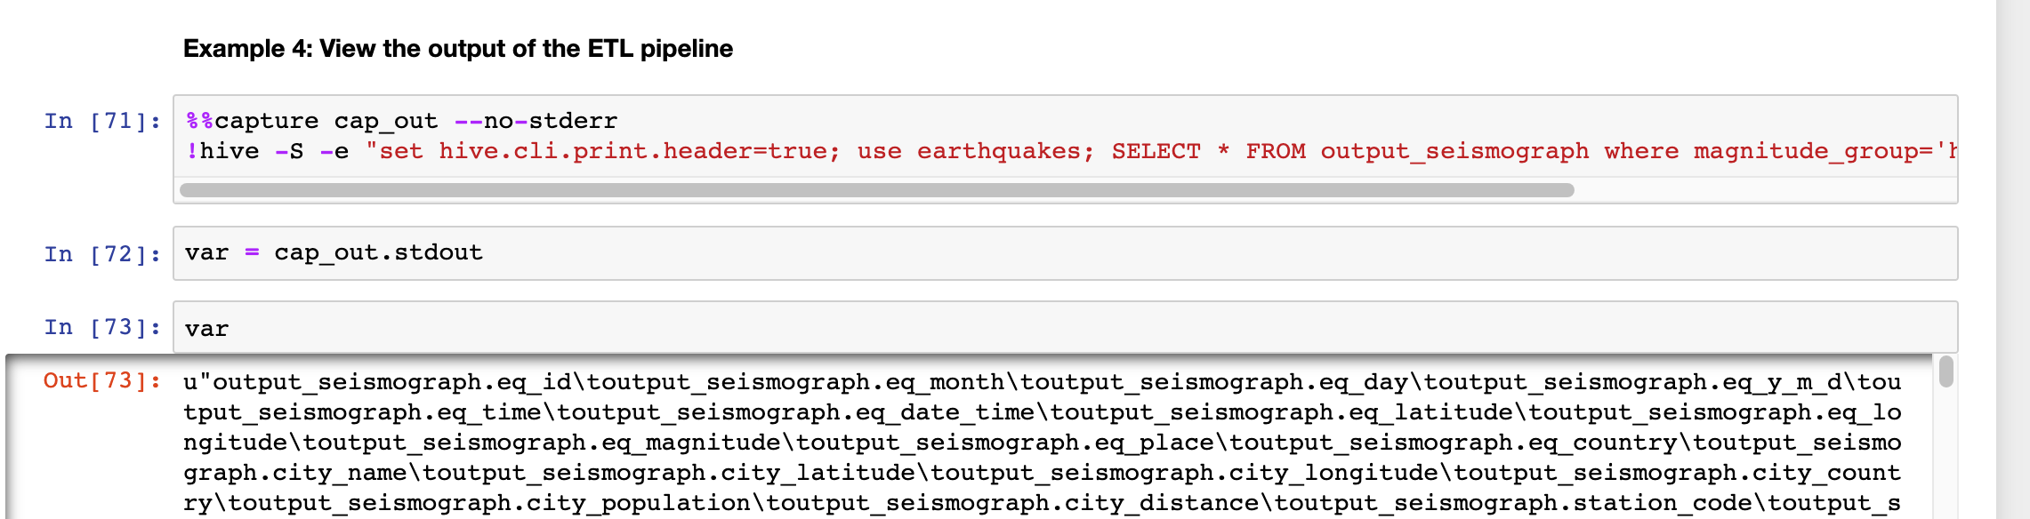
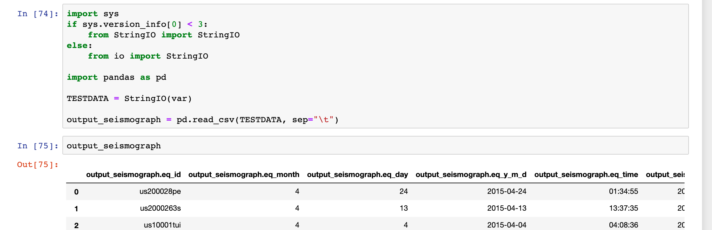
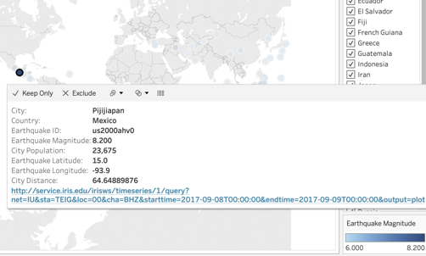
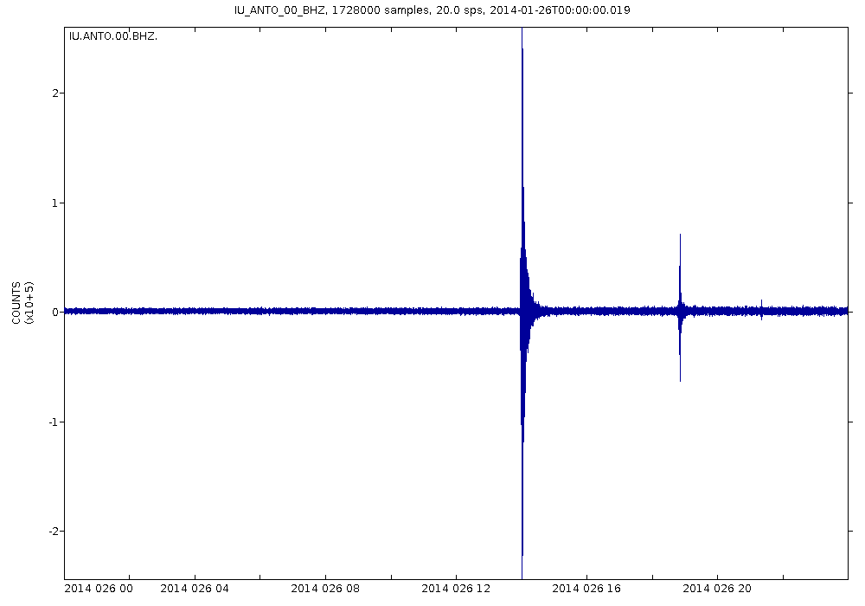
Sample results and further analysis
Hive - Cities and population affected by an earthquake
Jupyter – Data exploration, transforming the results to pandas data frame
Tableau - Visualization of the results
Link - Seismograph

Slide 5


Application architecture high level
process 1
Orchestration component
Reads configuration and orchestrates application’s processes
Earthquakes-History component
Responsible for phases 1,2
Hive-ETL-pipeline components
Responsible for phases 3,4
orchestration
component
process 2
passing control
passing control
process 3
returning control
returning control
earthquakes-history
component
hive-ETL-pipeline
component
Processes 2 and 3 can run individually
Phase 1
Phase 2
Phase 3
Phase 4
Acquisition
Preparation
Load to
HDFS
Hive database
preparation
ETL process
From slide 3 - Application concept – low level

Slide 6


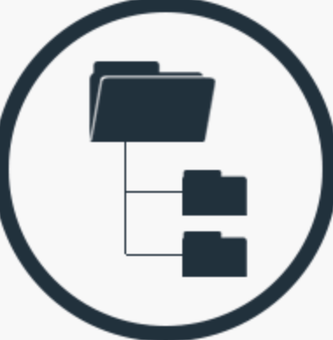

Application architecture low level
Properties
hdfs-path download-list-of-years download-group-of-years download-magnitude-over download-again-historical-data
hive-drop-all-tables
Earthquakes-history component
2.1. validate system input
2.3.1. for each day
Data Source
2.3.1.1 request
2.2. create a list of year
2.3.2. upload the data to HDFS
2.3.1.2 clear headers
USGS Rest API
Orchestration component
2.3. for each year
2.3.1.3 format date
Earthquakes
Data
2.3.1.4 format country
1.1. read the
configuration
passing control
2.4. program termination
2.3.1.5 store data
1.2. evaluate configuration properties
Hive-ETL-pipeline component
returning control
3.1. validate system input
3.5.1 load earthquakes data to Hive
1.3. system command to initiate
earthquakes-history component
3.2. create a list of files in HDFS
3.5.2 distance to all seismograph stations
passing control
Extract
Transform
Load
actions with
Hive
3.3. create database and tables
3.5.3 distance all to cities
1.4. system command to initiate
hive-ETL-pipeline component
3.4. import cities/seismograph stations to Hive
if not exists
3.5.4 distance to closest seismograph station
returning control
3.5. for each file
3.5.5 distance to closest city
1.5. program termination
3.6. program termination
3.5.6 output seismograph – closest city/station
Further analysis
4.1. hive quires
4.2. data exploration

Slide 7
Release 1.0 - Improvements
Configuration
Automation
Control
Performance

Slide 8
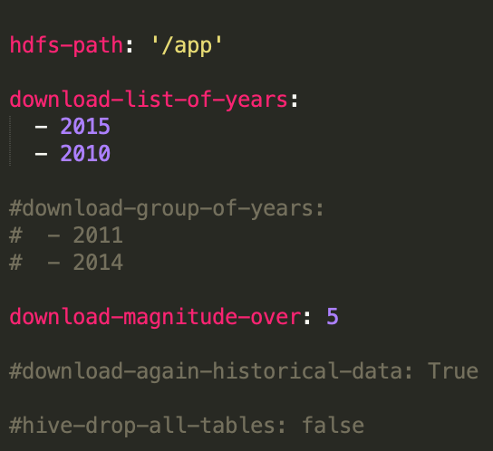
Configuration
The orchestration component reads the configuration file, in YAML format, and passes parameters to components
earthquakes-history and Hive-ETL-pipeline.
In this example, parameters hdfs-path, download-list-of-years and download-magnitude-over are being used.

Slide 9
Automation
Orchestration
With the designed architecture, the application orchestrates the components and the components perform the required tasks.
This approach allows us to use only a single component to execute a task without the need to run the whole orchestrated sequence.
Also, that design makes the application easy to extend by adding functionalities without significant changes. We can simply add new components in the execution sequence.
Passes control
The orchestration component reads the configuration and passes control to the components in order to execute the required tasks.
The orchestration component also passes input to other components. Those parameters can be input from the configuration file or the output of another component.
Hadoop ecosystem
The components are designed to interact with Hadoop services. Whenever a Hadoop action needs to be performed, a component sends instructions to a Hadoop service and waits until the action completes.

Slide 10
Control
Input validation
Every component is designed so to get system input and perform tasks based on that input.
Before performing those actions, a component validates that input and constructs a sequence of tasks.
Logs
Every component has its log file that states all actions performed in every execution phase.
The logs are extensively descriptive with the potential to conduct log analysis, extract further information and see system performance.
For instance, every Hive query actions are written in the logs so we can see map-reduce stages and possible errors.
Database
Components earthquakes-history and Hive-ETL-pipeline have its embedded database.
In those databases, the components write actions performed in the past in order to avoid possible data duplications (e.g. redownload data already processed) or spend execution time for unnecessary actions (try to re-create the Hive database or upload static data again).
Error handling
All components extensively utilize error handling so to control and provide a stable execution environment.
For instance, in case the configuration file is unavailable, the orchestration component writes an error in its log file and exits the application.

Slide 11
Performance - Hive advanced features
Partitions
A table can have one or more partition columns and a separate data directory is created for each distinct value combination in the partition columns. Further, tables or partitions can be bucketed using CLUSTERED BY columns, and data can be sorted within that bucket via SORT BY columns. This can improve performance on certain kinds of queries.
Buckets
Bucketed tables are fantastic in that they allow much more efficient sampling than do non-bucketed tables, and they may later allow for time saving operations such as mapside joins.
ORC format
The Optimized Row Columnar (ORC) file format provides a highly efficient way to store Hive data. It was designed to overcome limitations of the other Hive file formats. Using ORC files improves performance when Hive is reading, writing, and processing data.
Hive Command Line Options
Hivevar, variable substitution to apply to hive commands. e.g. --hivevar path='/app'
source: https://cwiki.apache.org/confluence/display/Hive/Home

Slide 12
Performance - Hive advanced features
Staging tables
Temporary tables that are used to stage the data for temporary purpose just before loading it to the target table from the Source Table.
e.g. loading data to a staging table with TEXTFILE format and the load these data to a table with ORC format.
Database location
Define the HDFS path in which the database will be created.
CASE expressions
Allow you to implement IF-THEN-ELSE logic in expressions (source: http://www.hplsql.org/)
e.g. Create a column magnitude-group and based on earthquake magnitude assigned a specific value (Low, Average, High, Extreme).
User defined functions
Hive QL can be extended with user code via user defined functions (UDFs)
e.g. add function written in python in order to populate the seismograph wave link. The function is being used by Hive quires.
Hive configuration properties
A number of configuration variables in Hive can be used by the administrator to change the behaviour for their installations and user sessions.
source: https://cwiki.apache.org/confluence/display/Hive/Home

Slide 13
Performance example – before using Hive advanced features
SELECT id, time, day, magnitude, country, city, population, city_distance
FROM earthquakes_distance_to_all_cities
WHERE id='us10007sd4’
AND population is NOT NULL
ORDER BY city_distance;
Took 10 minutes to run
in a VM with 8 cores and 16GB of RAM

Slide 14
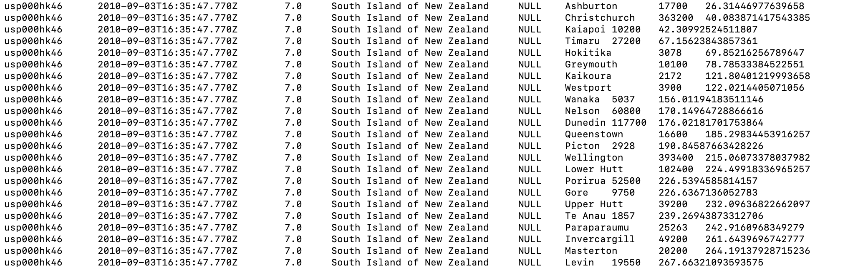
Performance example – after using Hive advanced features
SELECT eq_id, eq_date_time, eq_magnitude, eq_place,eq_country, city_name, city_population, city_distance
FROM distance_to_cities
WHERE eq_id='usp000hk46'
AND city_population is NOT NULL
ORDER BY city_distance;
Took 2 minutes to run
in a my laptop with 4 cores and 8GB of RAM

Slide 15
Demo
Application demonstrations with input: years to download 2010, 2015 and magnitude over 5.
We will present samples of:
Logs
HDFS structure
Hive Metastore
Jyputer notebook - Results presentation
The application took 2 hours and 15 minutes to complete
In a machine with 4 cores and 8 GB of RAM

Slide 16
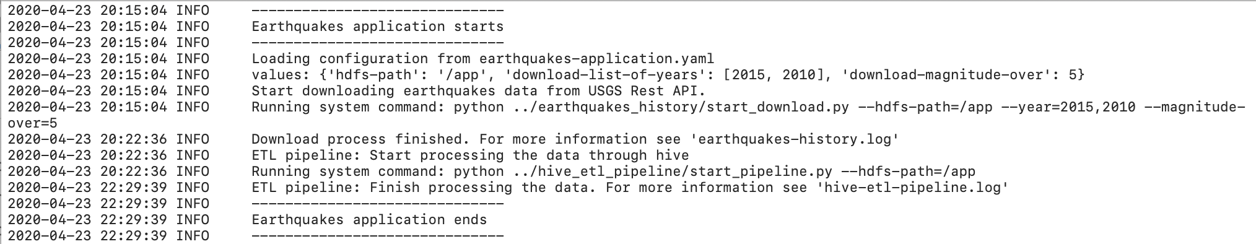
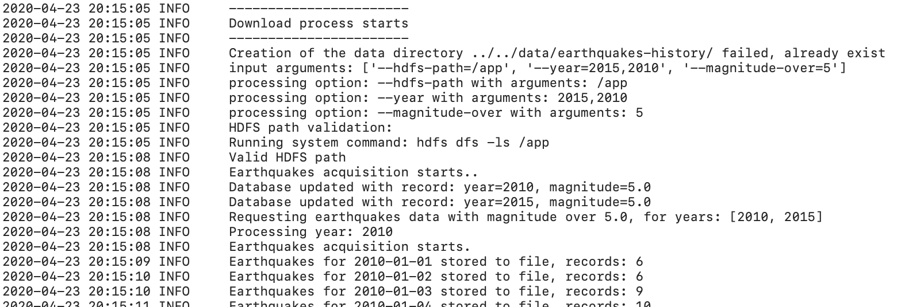
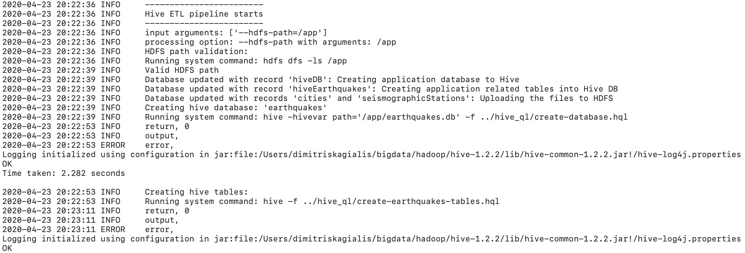
Log samples – Part A
1st execution
Demo execution with input:
hdfs-path = /app
download-list-of-years = 2015, 2010
download-magnitude-over = 5
Error handling
Input validation
passing control
passing control
1
Orchestration component log file
Error handling
Input validation
Interacting with HDFS
Error handling
Input validation
DB actions
Interacting with HDFS
Error handling
DB actions
Acquisition phase
Interacting with Hive
and capturing the output
2
Download-history component log file
3
hive-ETL-pipeline component log file
It can be seen from the logs that the application took 2 hours and 15 minutes to complete.
Also, as this is the first time we execute the application in this Hadoop environment, hive-ETL-pipeline.log states that database, tables and static data will be created.

Slide 17
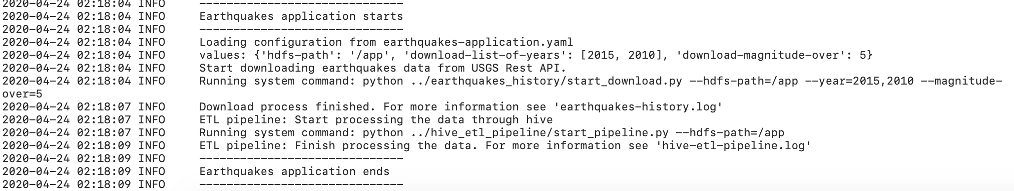
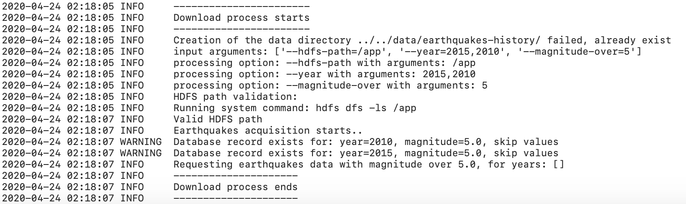
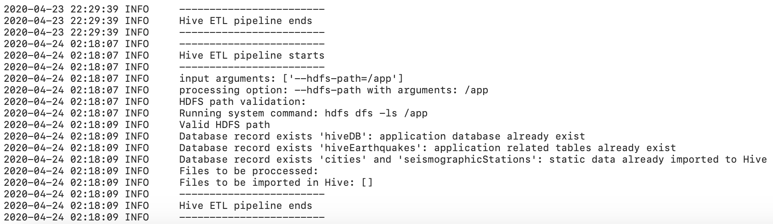
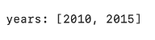
Log samples – Part B
2nd execution
Demo execution with input:
hdfs-path = /app
download-list-of-years = 2015, 2010
download-magnitude-over = 5
Error handling
Input validation
passing control
passing control
We run the application
with the same input
1
Orchestration component log file
Error handling
End of 1st execution
Input validation
End of 2nd execution
Interacting with HDFS
Error handling
Input validation
DB actions
Interacting with HDFS
Error handling
Acquisition phase
NULL
DB actions
2
Download-history component log file
Interacting with Hive
and capturing the output
NULL
Log from the 1st executions
3
hive-ETL-pipeline component log file
Log from the 1st executions
Having run the application with the same input, we see that took 5 seconds to complete.
The earthquakes-download component searches on its database and sees that the required data have been requested in the past.
Because of this, no data are being requested, uploaded to HDFS, and hive-ETL-pipeline component finds no data to process.
Also, the hive-ETL-pipeline component searched on its database and saw that database, tables, and static data had been created to Hive;
therefore, it skips those steps.

Slide 18
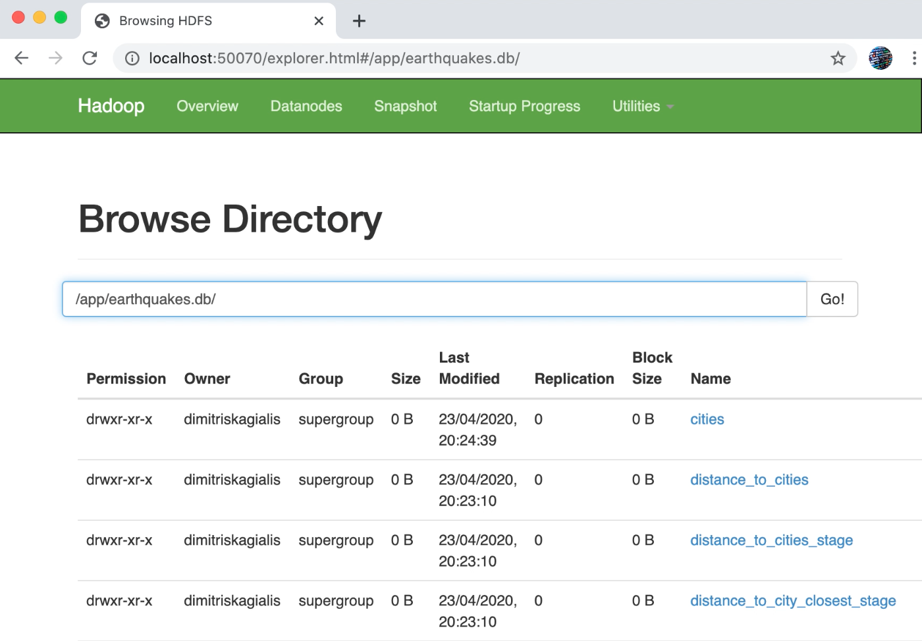
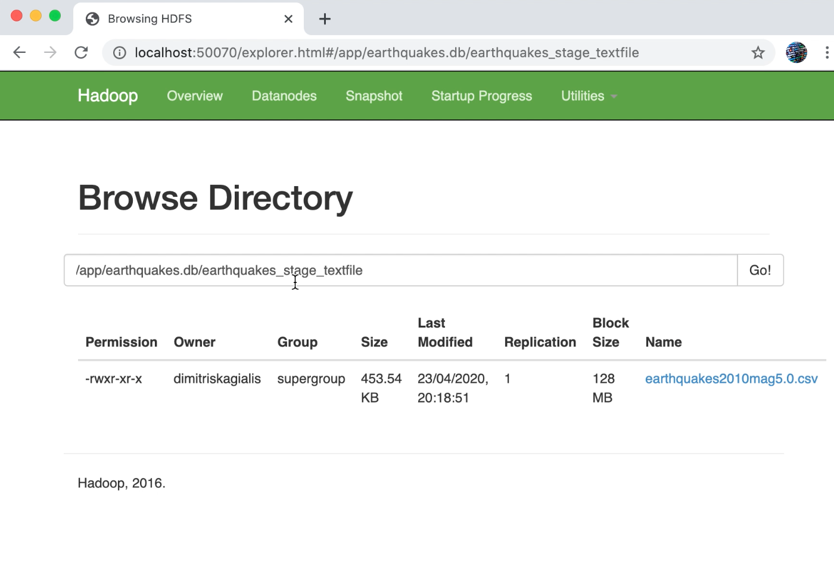
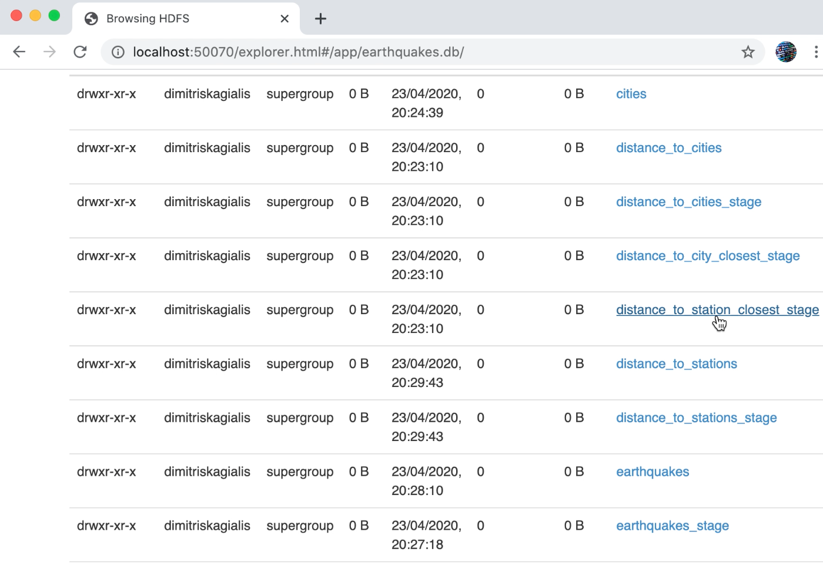
HDFS samples – Part A
1
Creating application database and tables
2
Importing earthquakes data to
a staging table with TEXTFILE format
Database folder
The hive-ETL-pipeline component creates the application’s database and
tables [Figure 1], and loads the static data (cities and seismograph stations).
Then for each data file, the component imports the data into a staging table
with TEXTFILE format [Figure 2]. That file is in clear text, and the user
can be download and read its content.
Hive tables in HDFS

Slide 19
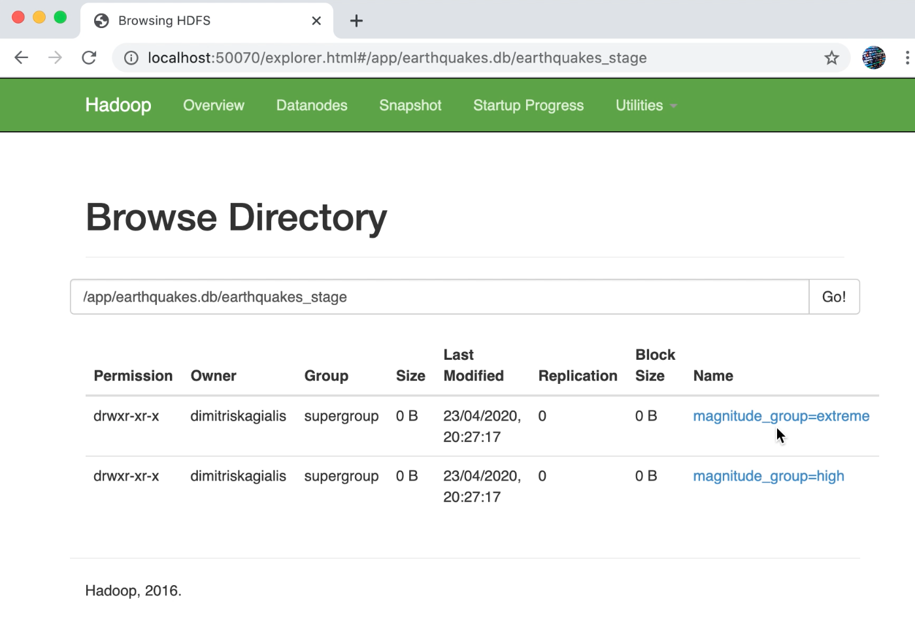
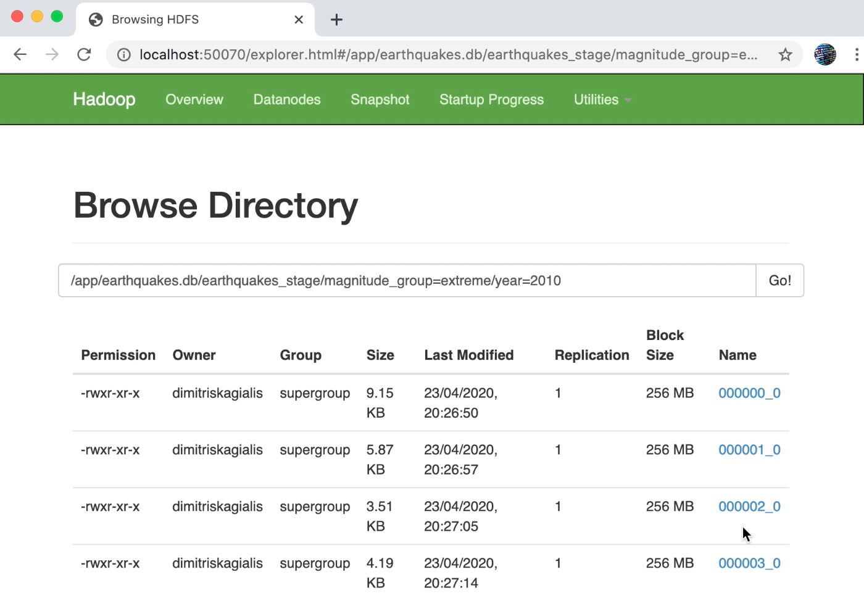
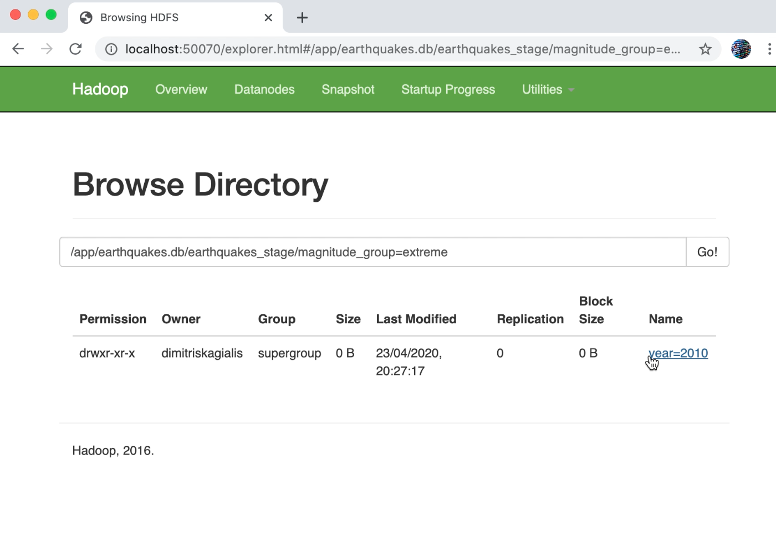
HDFS samples – Part B
1
Importing earthquakes data to
a staging table with ORC format
The hive-ETL-pipeline component loads the data from the TEXTFILE staging table to the ORC staging table. This table contains only data for the current processing year (2010).
Data in the ORC table are structured with partitions based on magnitude group [Figure 1] and year [Figure 2].
Finally, the data are separated into four buckets [Figure 23, and the user now is not able to download read the context of those files.
Partitions in HDFS
1st level
3
Earthquakes data separated
into four buckets in ORC format
2
Creating a hierarchy of partitions
Partitions in HDFS
2nd level
Buckets in HDFS

Slide 20
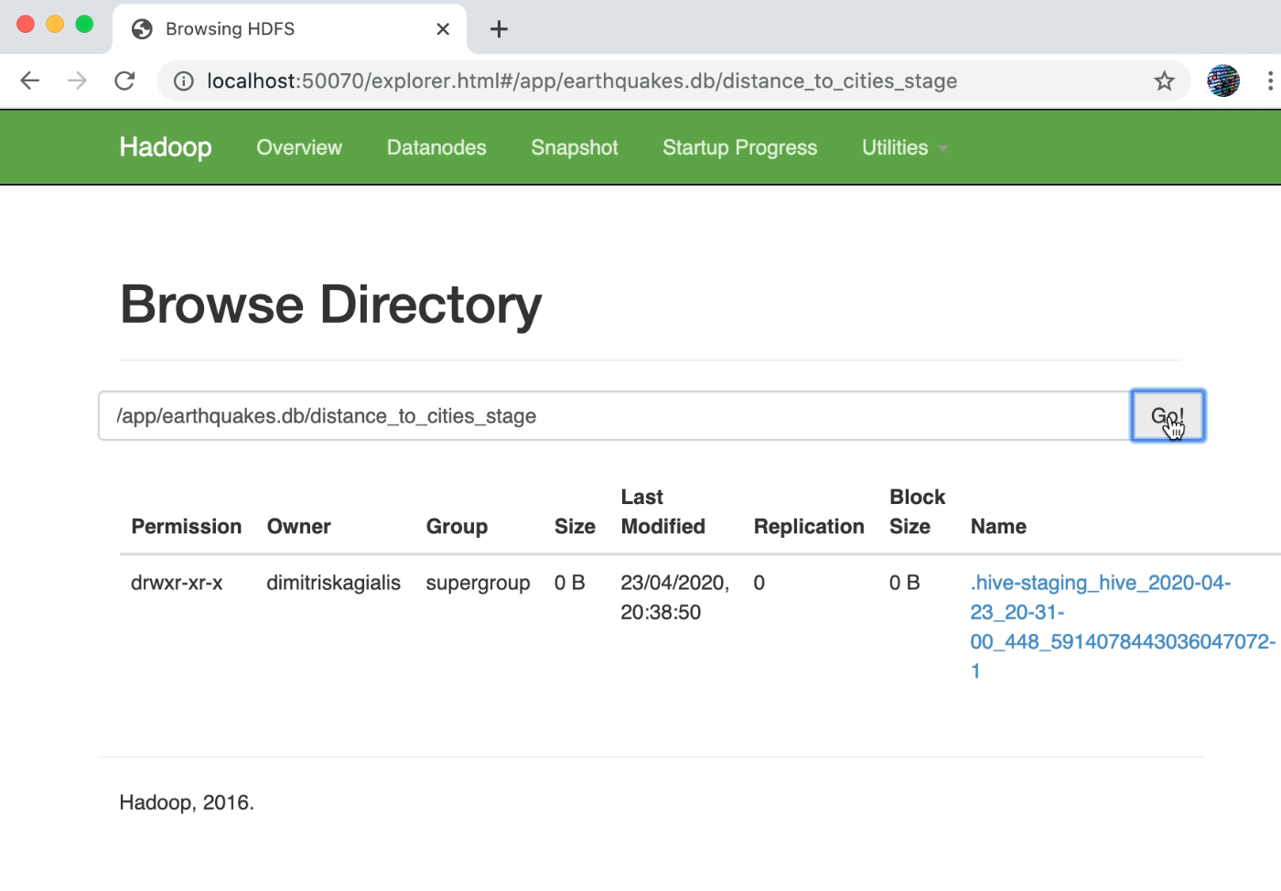
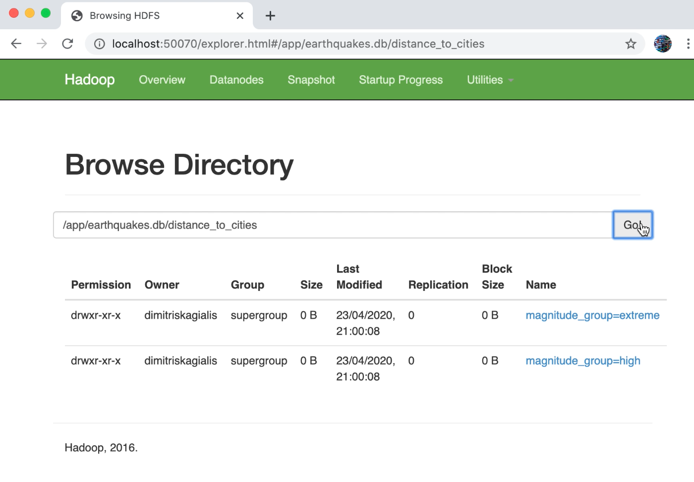
HDFS samples – Part C
1
HDFS file while a Hive job is being executed
2
HDFS folder structure after Hive’s Job completion
Hive Job
staging phase
Hive job has
been completed
Hive-ETL-pipeline step 4.3 distance to all cities [slide 3] performs a cross join, also known as a Cartesian join, e.g. if we have a table earthquakes with 1000 rows and a table cities with 10000 rows, the result will be a table with 100 x 1.000 = 100.000 rows. While the query constructs the cross join also calculates the distance to each city. This type of join is one of the most resource-intensive, and it can be seen from the figures that it took more than 20 minutes to complete.
While the query is being executed, Hive creates map-reduce jobs. These jobs temporary store output data to a staging file into HDFS [Figure 1].
When the execution has been completed, the HDFS creates the table structure, with related partitions and buckets [Figure 2].

Slide 21
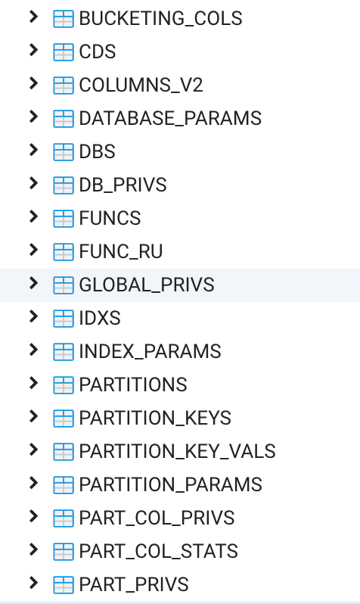
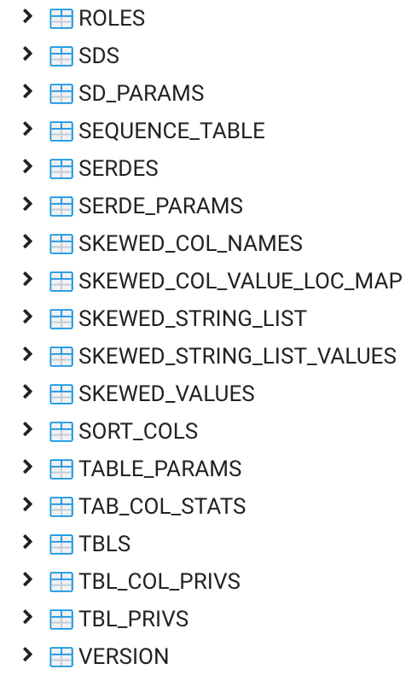
Hive Metastore samples Tables in Hive Metastore

Slide 22
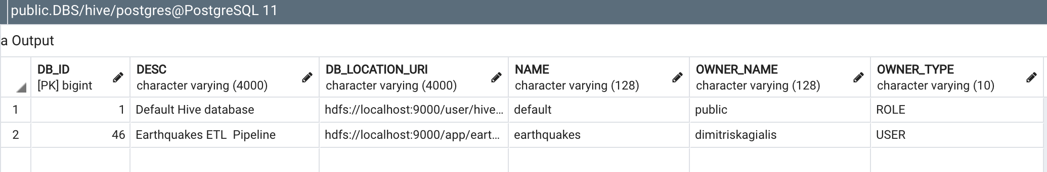
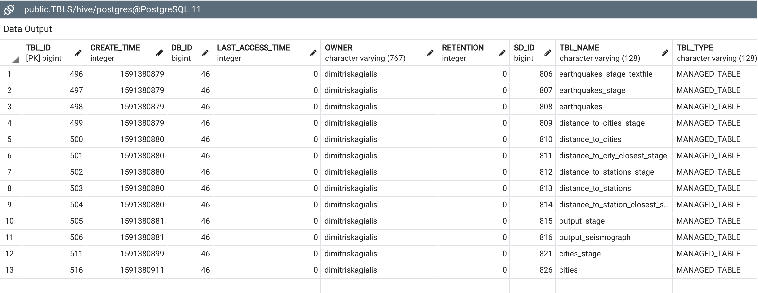
Hive Metastore samples Hive Databases and application tables

Slide 23
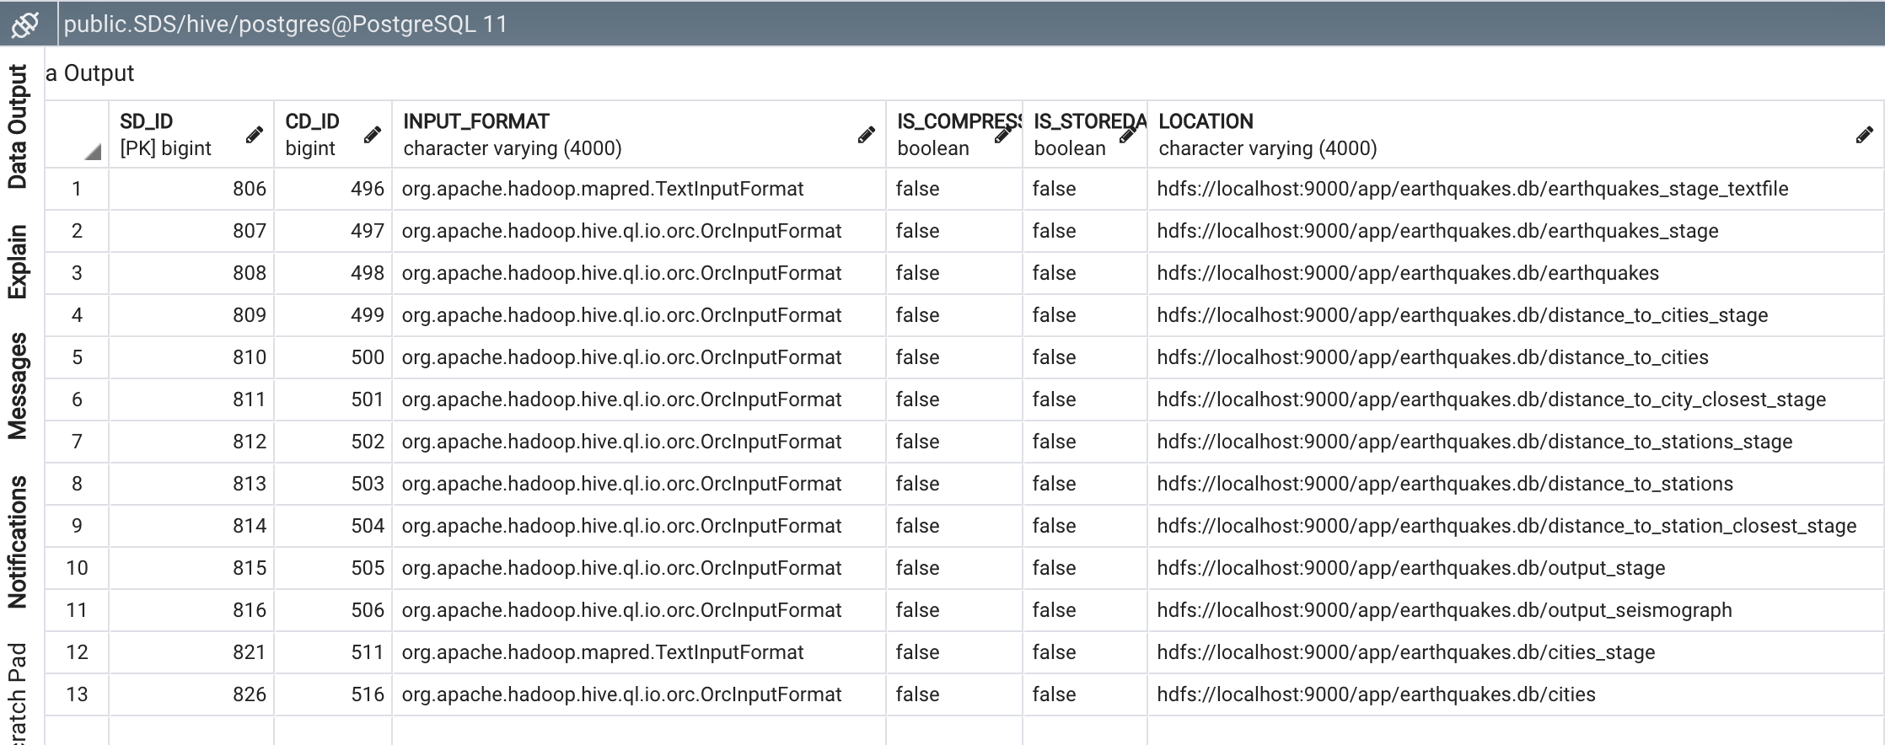
Hive Metastore samples Application tables format and HDFS path

Slide 24
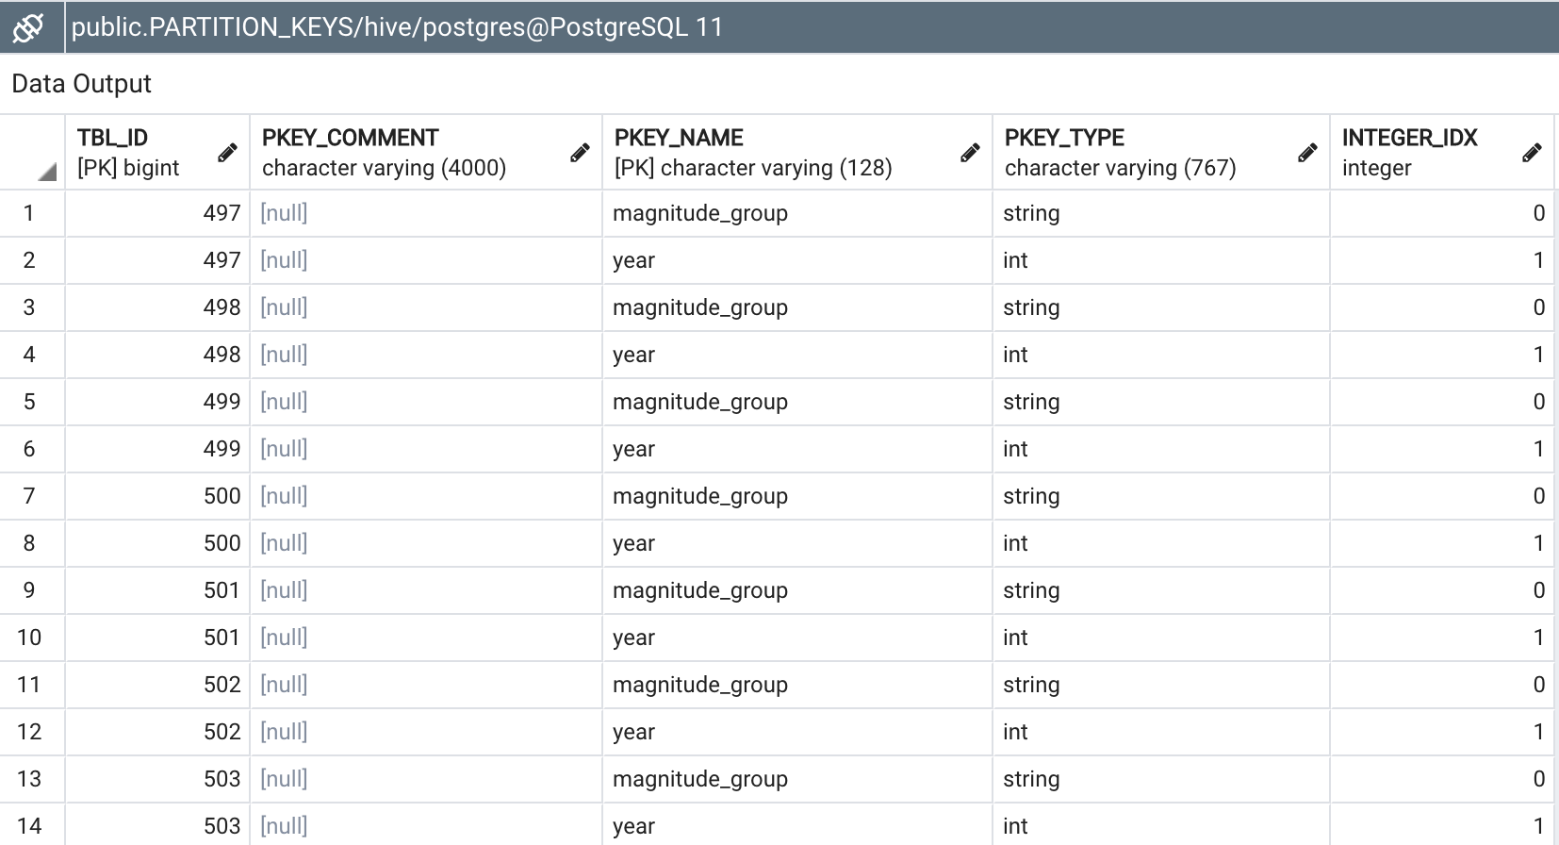
Hive Metastore samples Hive partitions per table

Slide 25
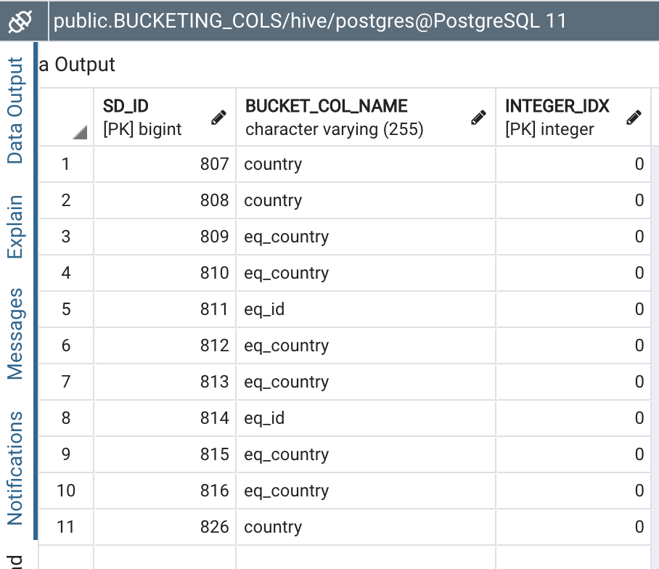
Hive Metastore samples Hive buckets per table

Slide 26
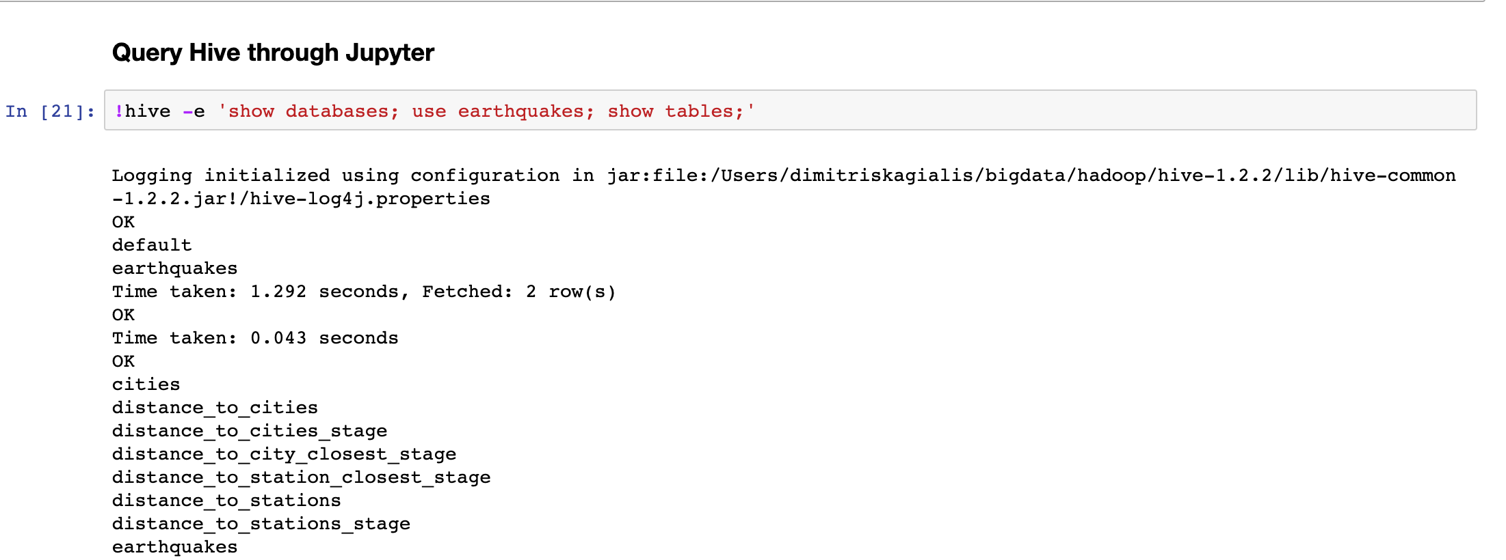
Jyputer notebook - Results presentation Use of ! to query hive

Slide 27
Jyputer notebook - Results presentation Use of ! to query hive

Slide 28
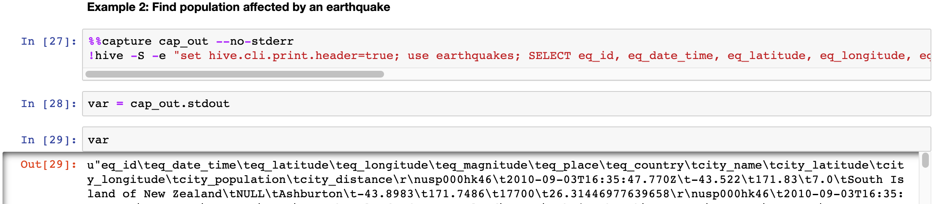
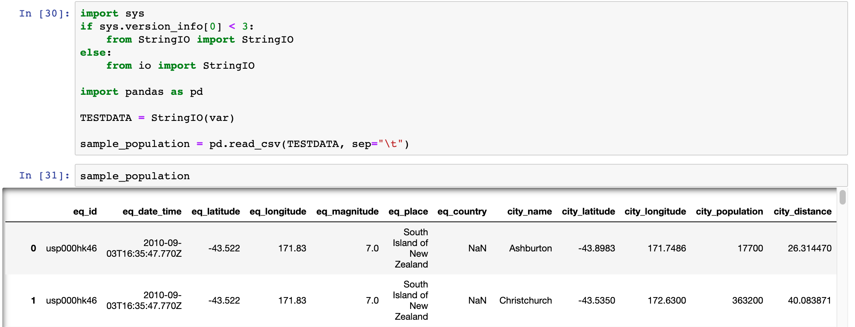
Jyputer notebook - Results presentation Capture Hive output and create data frames

Slide 29
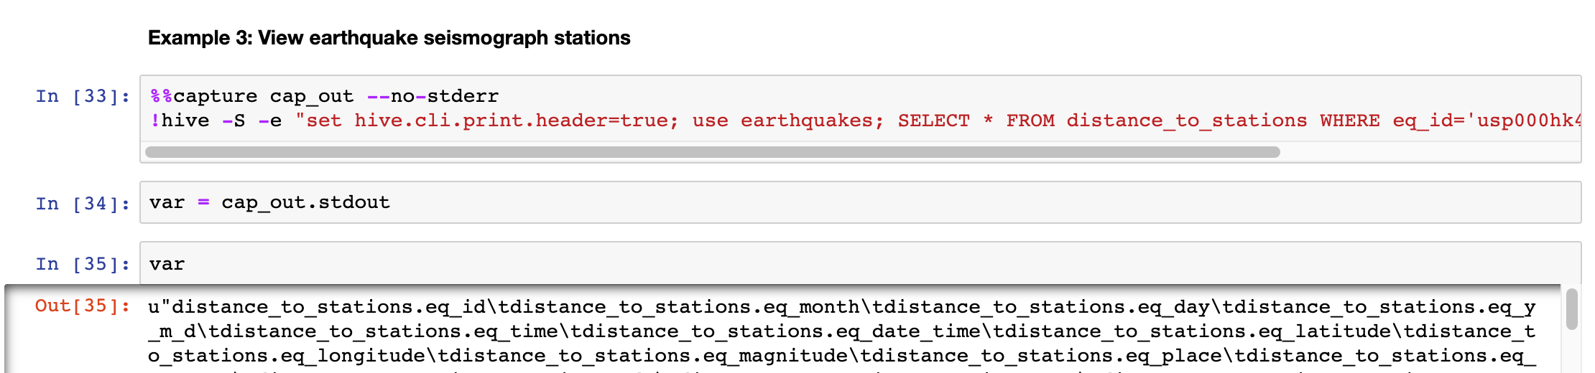
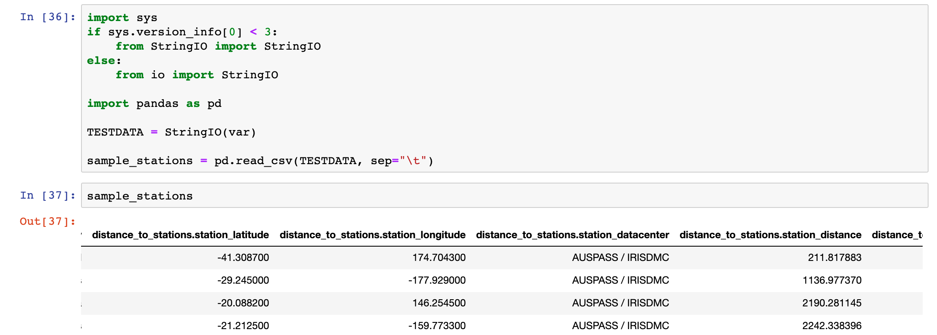
Jyputer notebook - Results presentation Capture Hive output and create data frames

Slide 30
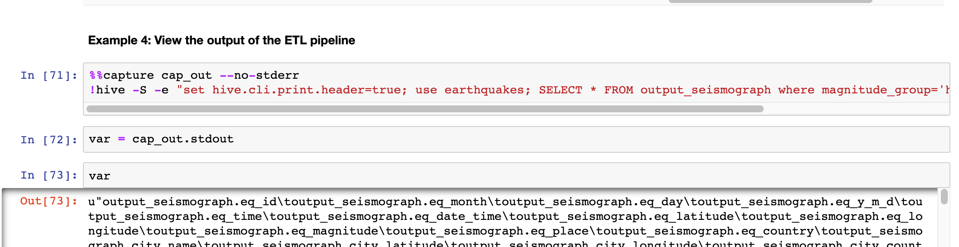
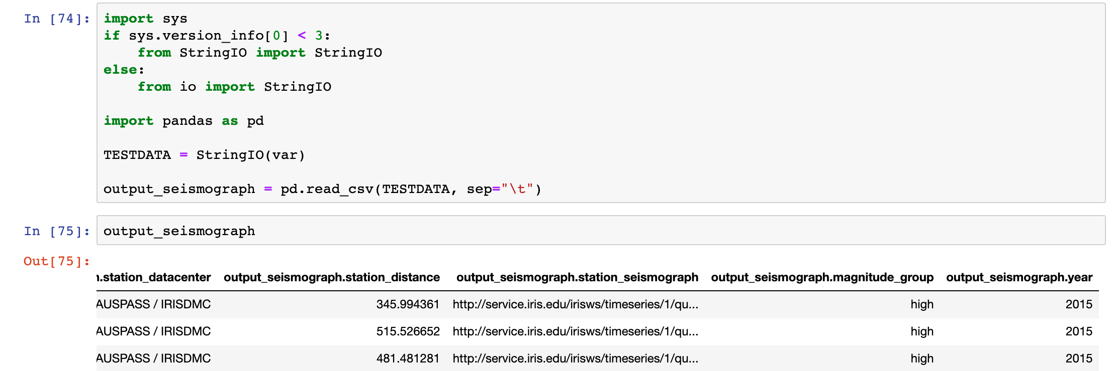
Jyputer notebook - Results presentation Capture Hive output and create data frames

Slide 31
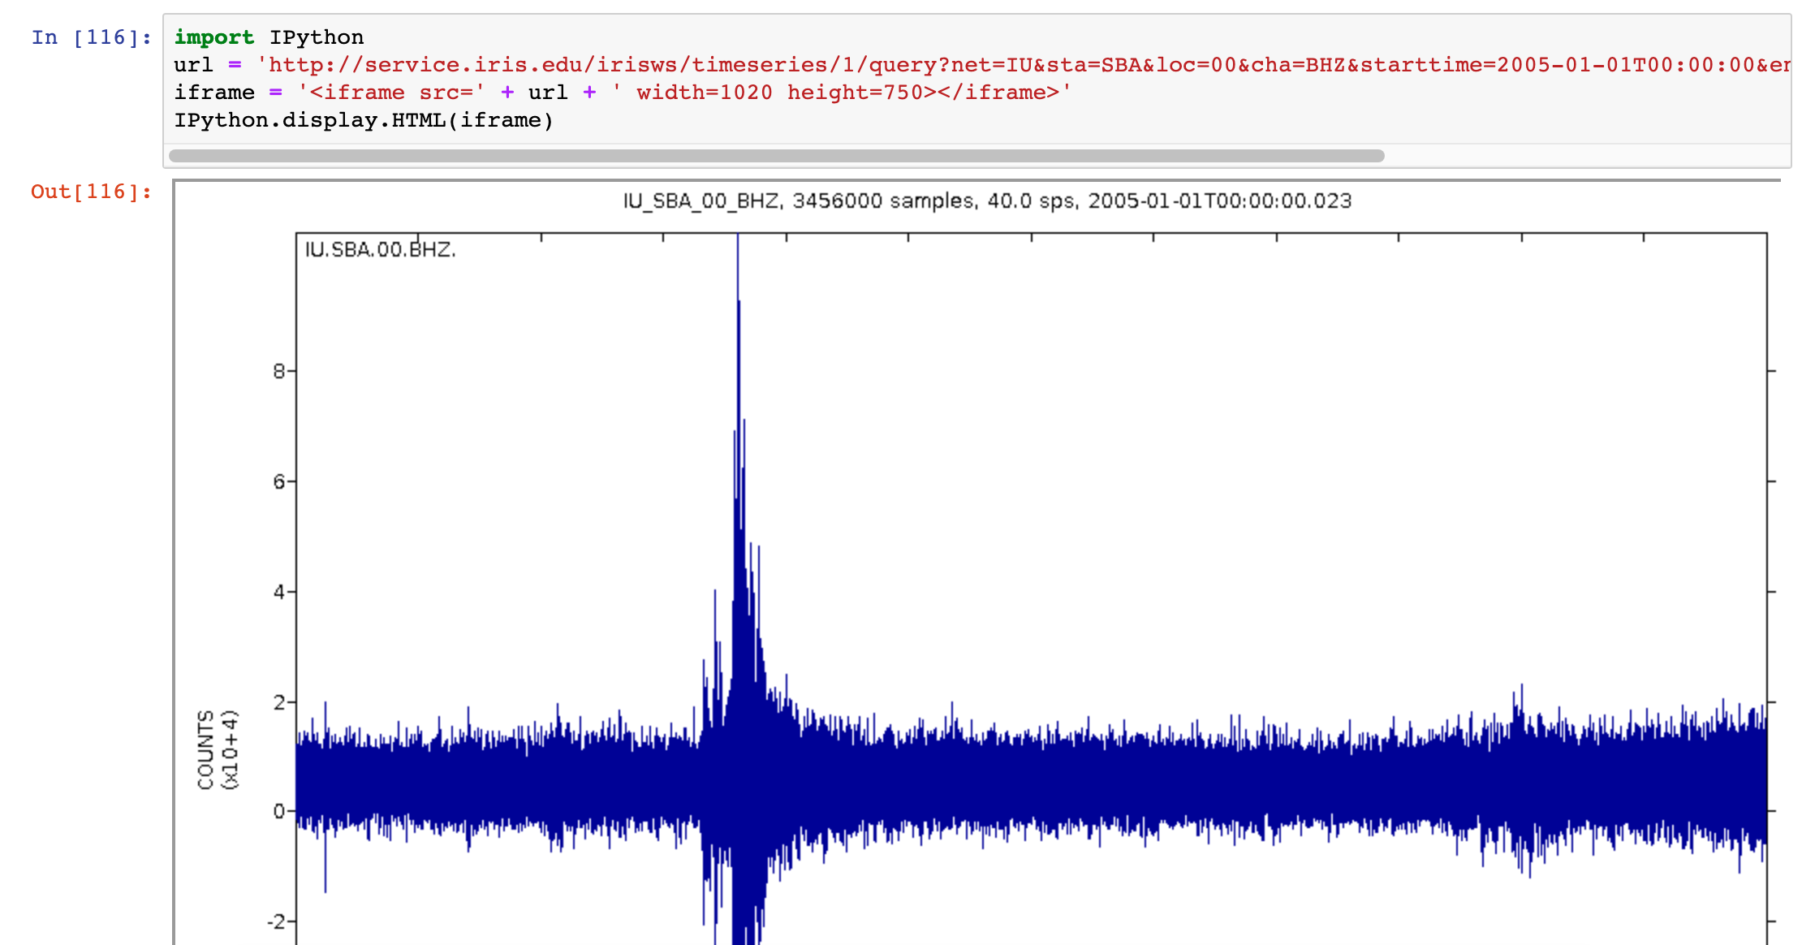
Jyputer notebook - Results presentation View a seismograph by using IPython

Slide 32
Available Sources
Automation of the Earthquakes Hive ETL pipeline – Tutorial source:
https://github.com/UoW-CPC/rabbda-earthquakes-portal/tree/release-1.0

